Slide 1
Introduction to R and the world of data analysis and visualization
By Eli Louise

Slide 2
Presentation’s format
What is R?
The Scope of R’s capability for data analysis and visualization
Examples of data visualization techniques in R
Data Visualization Exercises

Slide 3


What is R?
R is a programming language mainly used for statistical and graphical types of work.
Its popularity is getting better day by day.
In 2016 it was ranked second in a category of programming languages for data science.
R is one of the highest paid IT skill

Slide 4




The Scope of R’s capability for data analysis and visualization
R language is used extensively
Google uses R to predict economic activity
Ford uses R to improve the design of it’s vehicle
Twitter uses R to monitor user experience
Facebook – For behavior analysis related to status updates and profile pictures

Slide 5

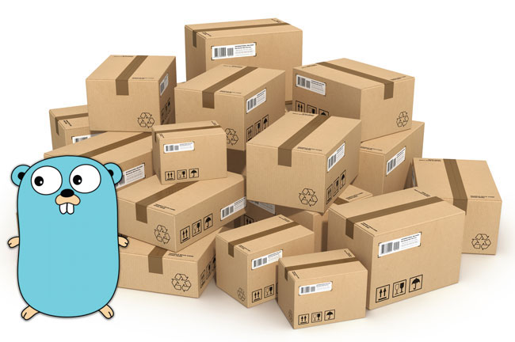
R has seemingly limitless capabilities.
But many, if not all of the most useful R functions, come in packages.
As of January 2015, there were over 6,000 packages available on the Comprehensive R Archive Network, or CRAN, the public clearing house for R packages

Slide 6
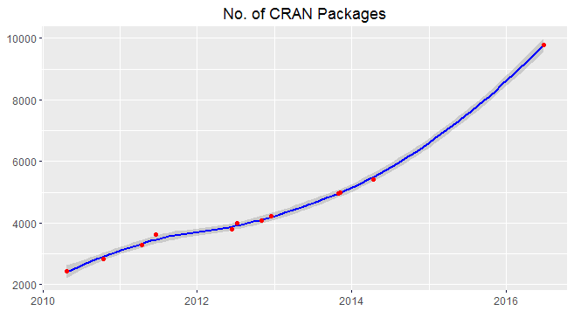
This huge variety of packages is one of the reasons that R is so successful!
In the graph below, we can see the growth rate of packages is very high. It implies more and more people are taking interest in R.

Slide 7

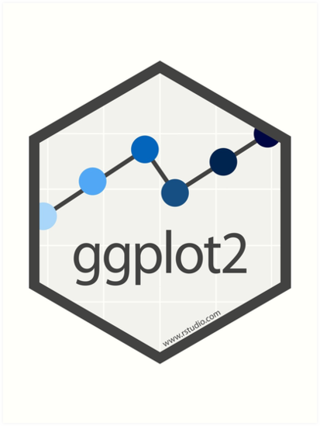





So what are packages exactly and why are they so useful?
R packages are collections of functions and data sets. They increase the power of R by improving existing functionality. Here are some examples of the most popular packages:
[source:https://www.rdocumentation.org/trends]
Readxl : Allow the transfer of excel files into R
RMySQL, RPostGresSQL, RSQLite : Reading data from a database ggplot2: R’s famous package for making beautiful graphics rgl: Interactive 3D visualizations with R

Slide 8

Example of data visualization techniques in R

Slide 9
Data Visualization Exercises

